Slide 1
Ski Resort Workforce Challenges and Solutions

Slide 2
Workforce Challenges among the most acute issues facing Ski Resorts

Slide 4
Filling vacancies difficult for all industries, but especially hard for jobs that are…

Slide 5
Ski Resort Workforce Trends

Slide 6
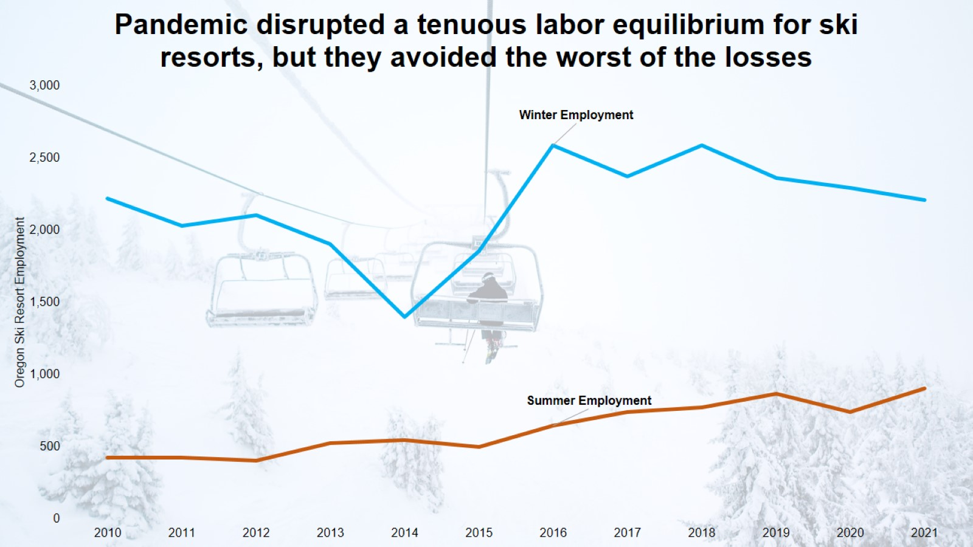

Slide 8
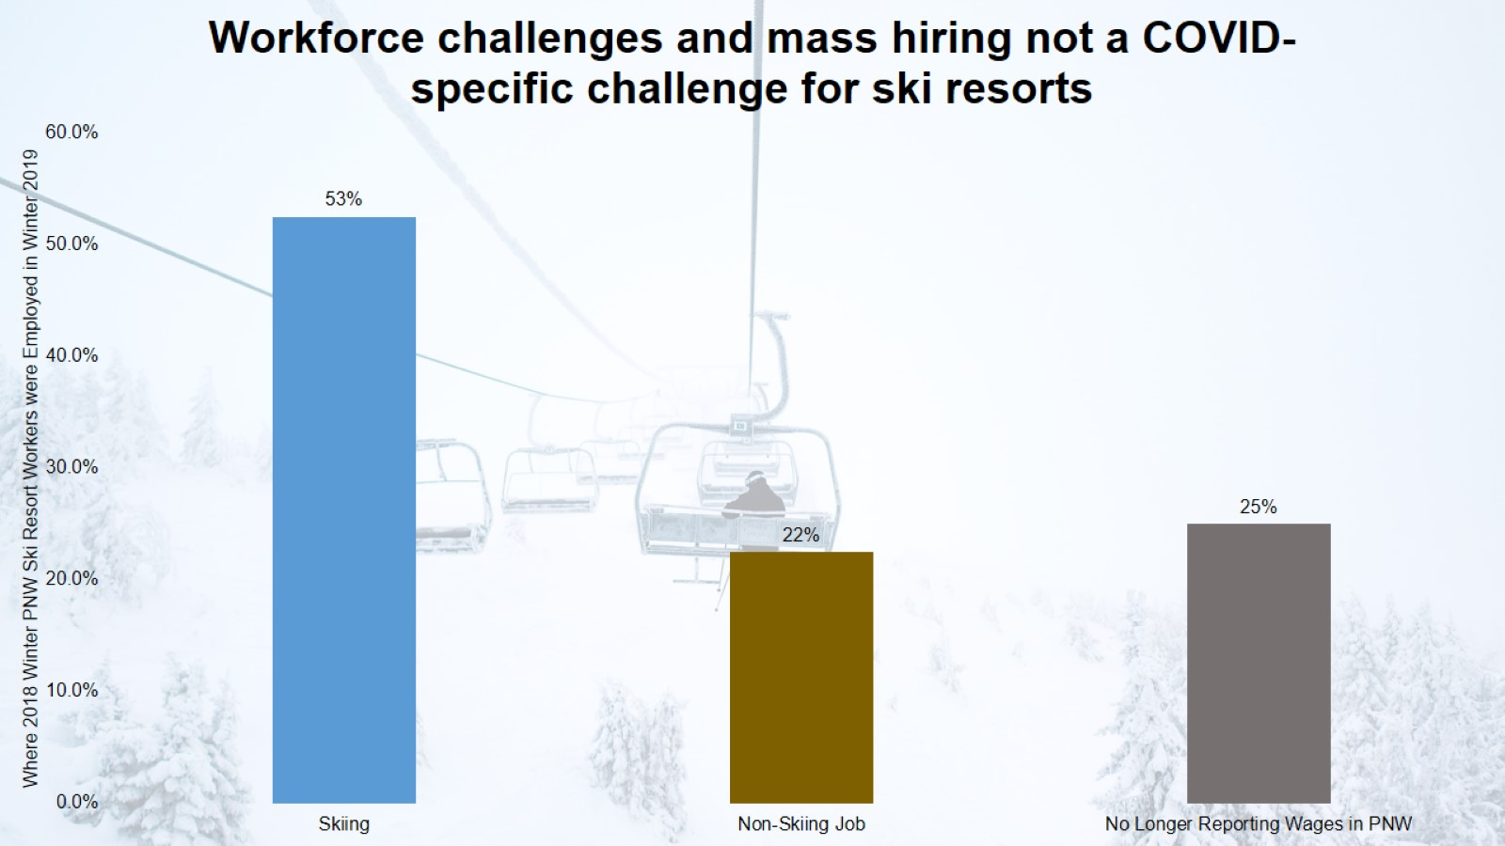

Slide 9
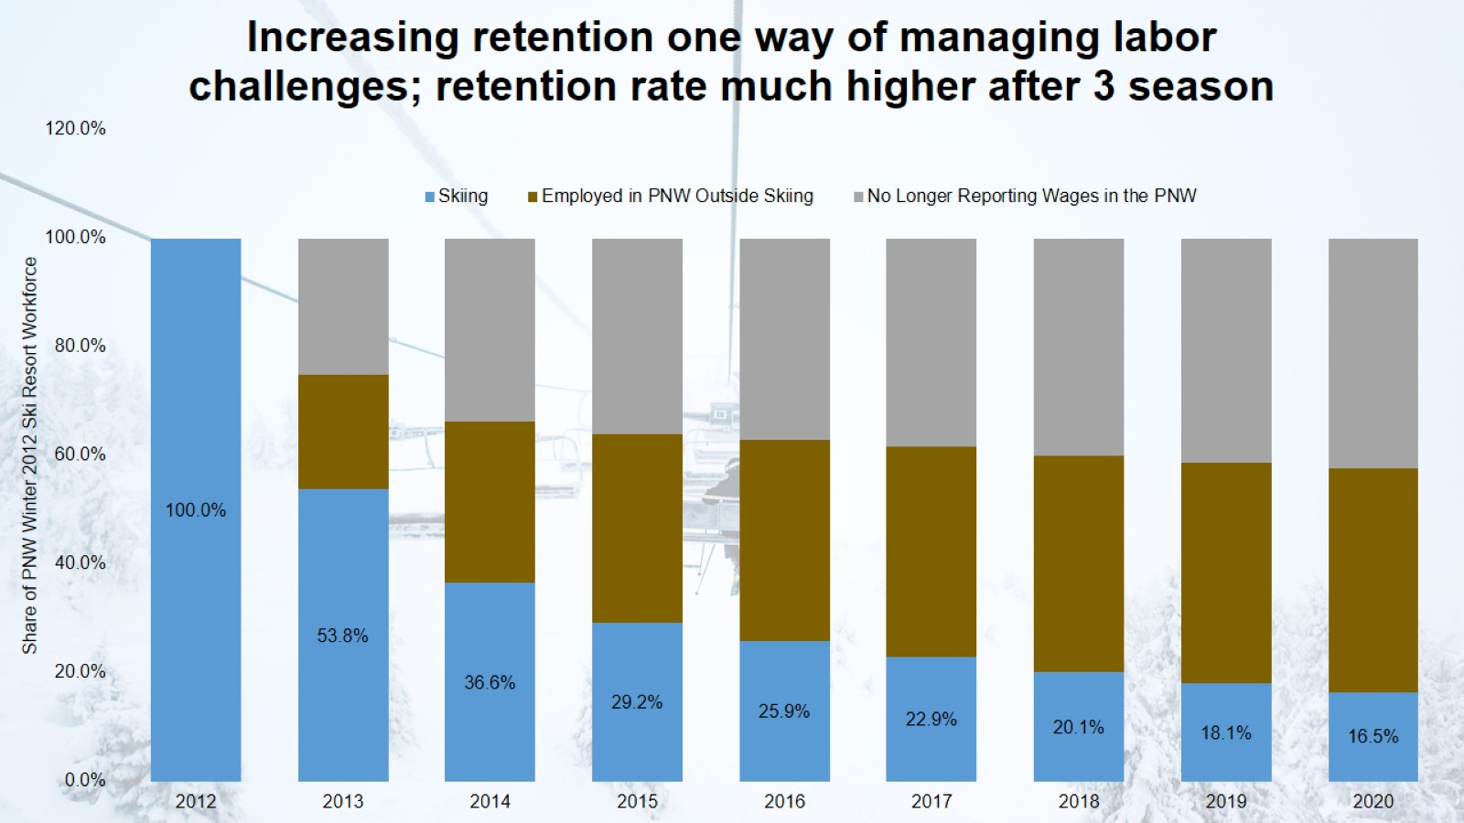

Slide 11
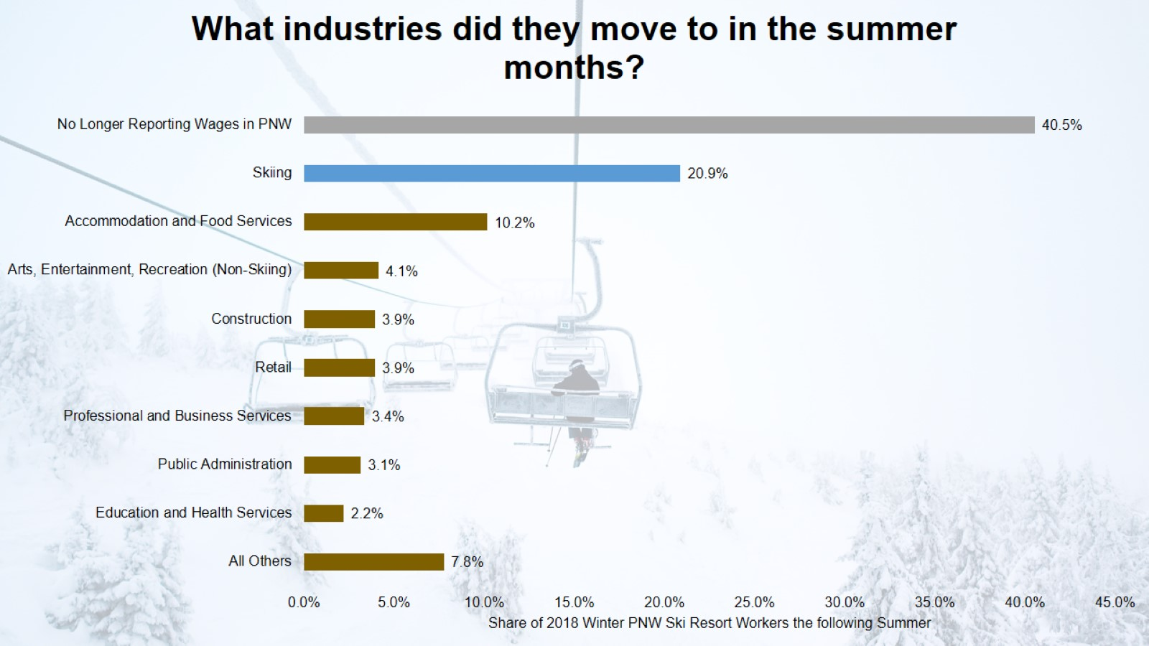

Slide 12
Improving Retention & Recruitment Tap into businesses who employ ski resort workers in summer months

Slide 13
Improving Retention & Recruitment Collaborating with the broader water workforce

Slide 15
Improving Retention & Recruitment Innovative Housing Solutions

